Slide 1
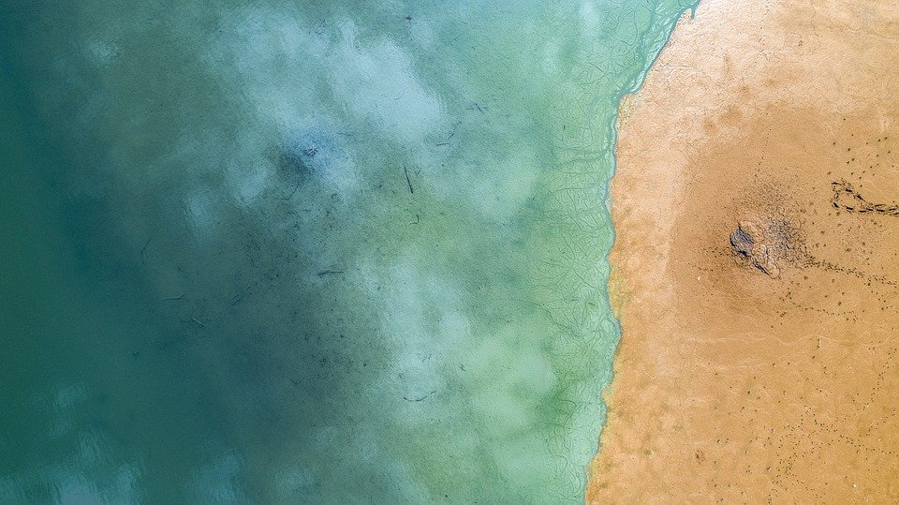
Analysis of Ground Water Levels in the State of Colorado
1980-2020

Slide 2
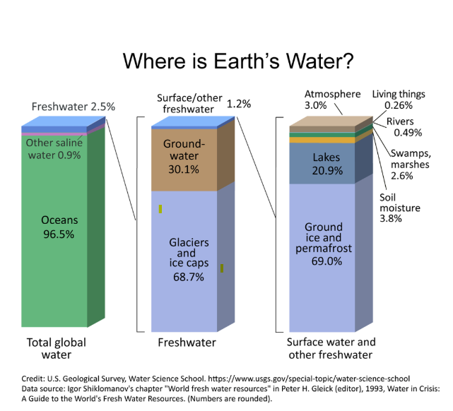
Overview
Over 98 % of the Earth’s useable fresh water is located in the ground
An understanding of the Earth’s ground water volumes and use is critical to planning for a sustainable economic and environmental future
This understanding is of greatest importance in arid environments where water sources are scarce, such as the western United States

Slide 3
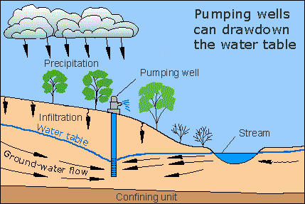
Ground Water Measurement overview
Ground water levels are measured from wells drilled into an aquifer
Ground water levels increase or decrease based upon the balance of charge (infiltration, flow) and discharge (pumping, negative-flow)
By measuring water levels through time, a net increase or decrease in aquifer volumes can be assessed

Slide 4
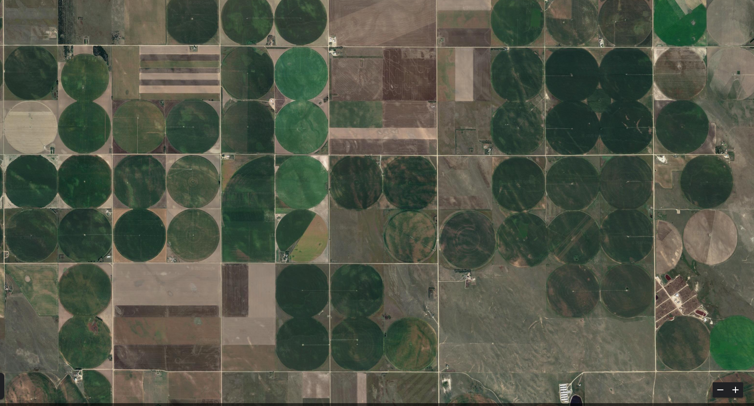
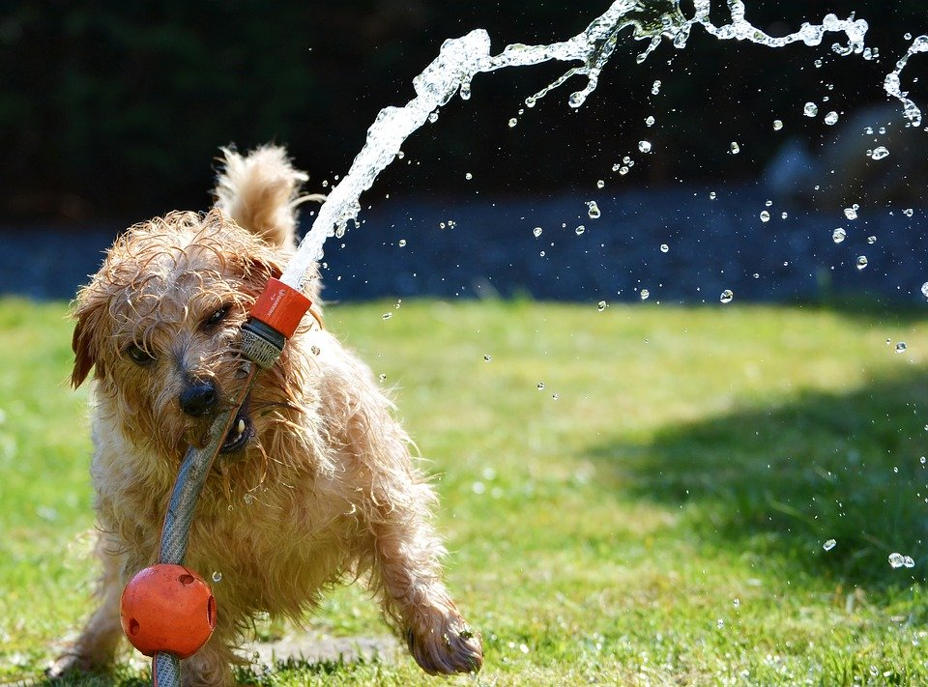
Problem statement
Yuma County, Colorado
Have ground water levels increased or decreased in the state of Colorado from 1980-2020?
How has ground water change from 1980-2020 changed by area and aquifer formation?

Slide 5
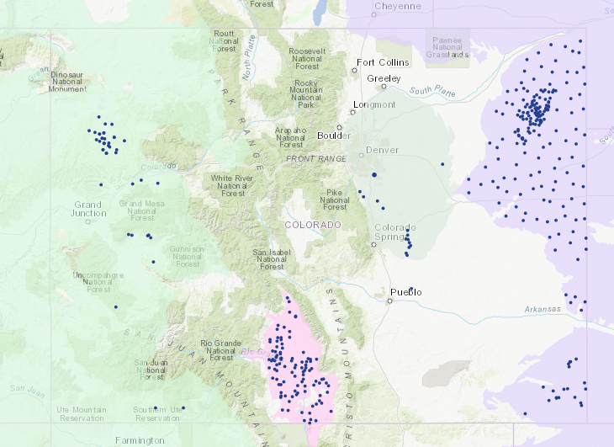
Data Analyzed
Ground water level data for Colorado was derived from the National Ground Water Monitoring Network
Data coverage is not great. Many areas of the state have poor data coverage or none at all.
The data is composed of two csv files: Data here
Site information for 299 wells (Site number identifier, location, depth, aquifer, aquifer type
Water level measurements ( n > 63,000)
site number identifier, measurement date, water level
Wells without data prior to 01/01/1990 were omitted
Resulted in 221 wells and 19,220 well level measurements for analysis
Water Depth Measurement Well
Denver
High Plains
Colorado Plateau
Rio Grande

Slide 6
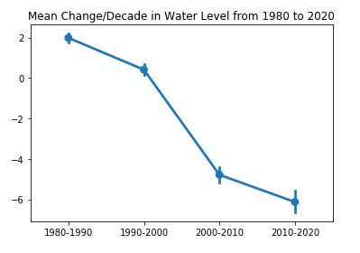
Statitically significant difference in ground water levels in Colorado from 1980 - 2020
With 95% confidence, the mean change in ground water depth from measurements taken between 1980-1990 and 2010-2020 is between 7.1 and 8.5 ft

Slide 7
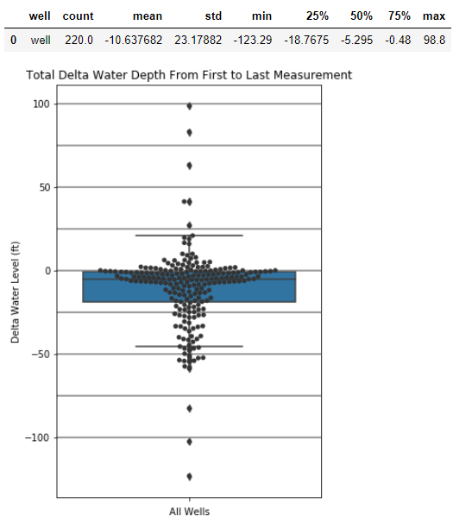
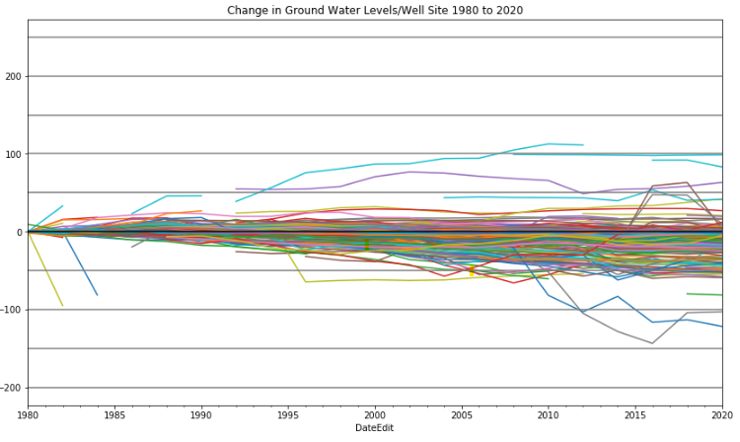
Water Level Changes from Base Line Through TIme: All Wells
The total change from each well was calculated (well depth start- well depth latest)
On average well levels have fallen by at least 10’ since 1980

Slide 8
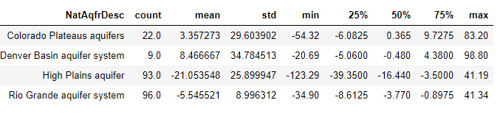
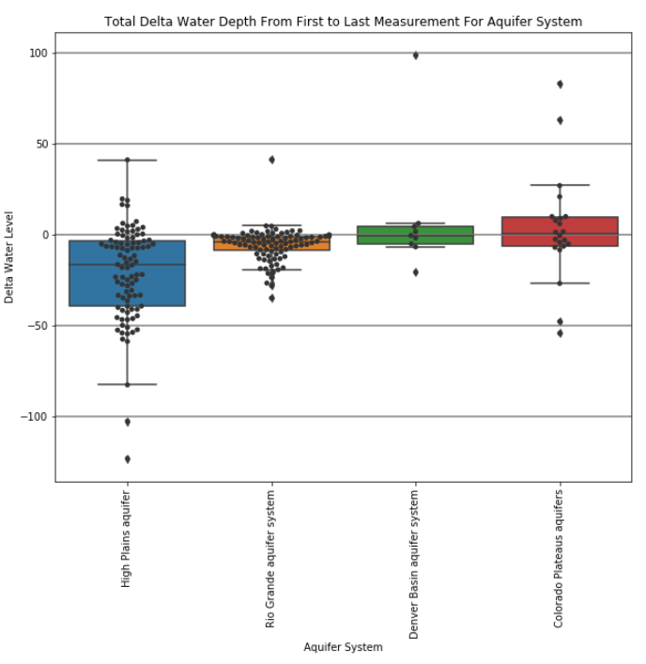
Delta Water Level from Base Line to 2020: Aquifer System
Water Depth Measurement Well
Denver
Basin
Colorado Plateau
High Plains
Rio Grande

Slide 9
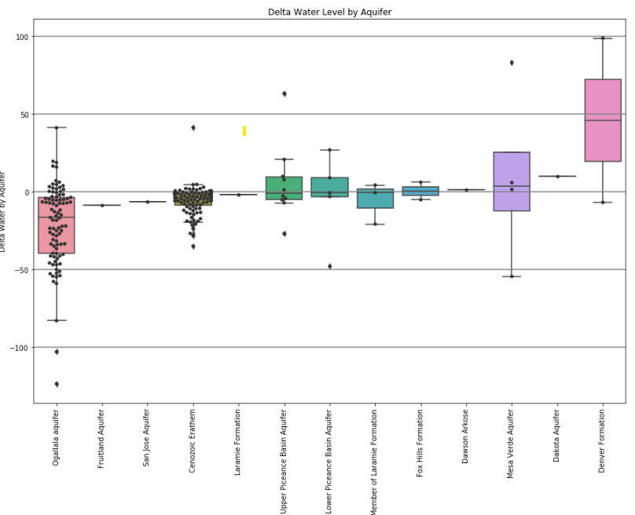
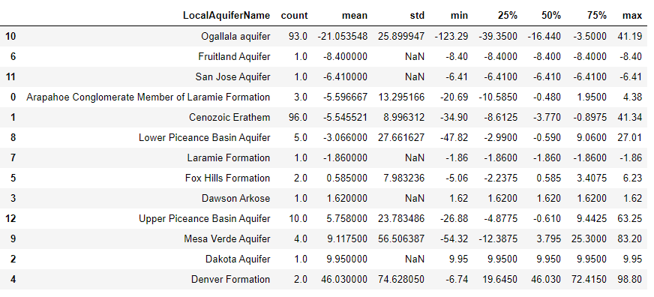
Delta Water Level from Base Line to 2020: By aquifer Formation

Slide 10
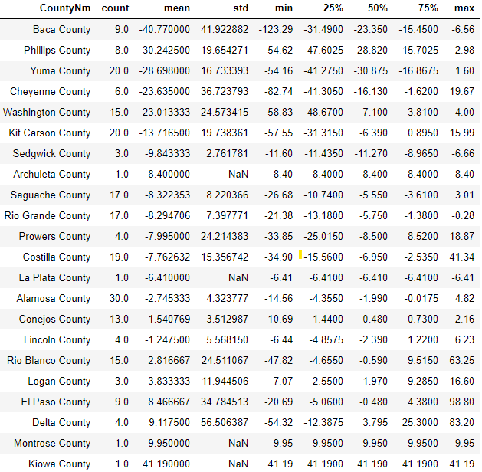
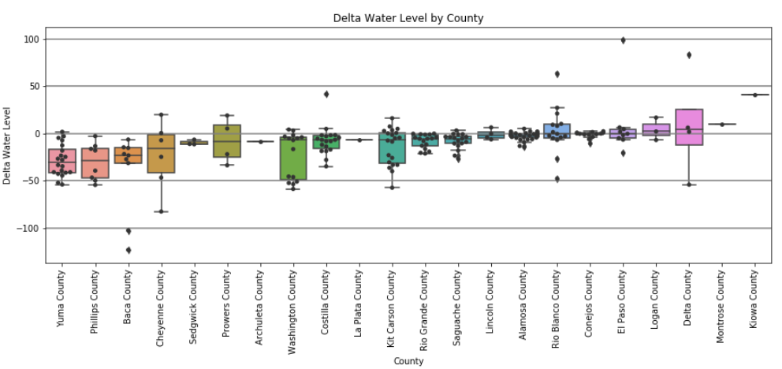
Delta Water Level from Base Line to 2020: By aquifer Formation

Slide 11
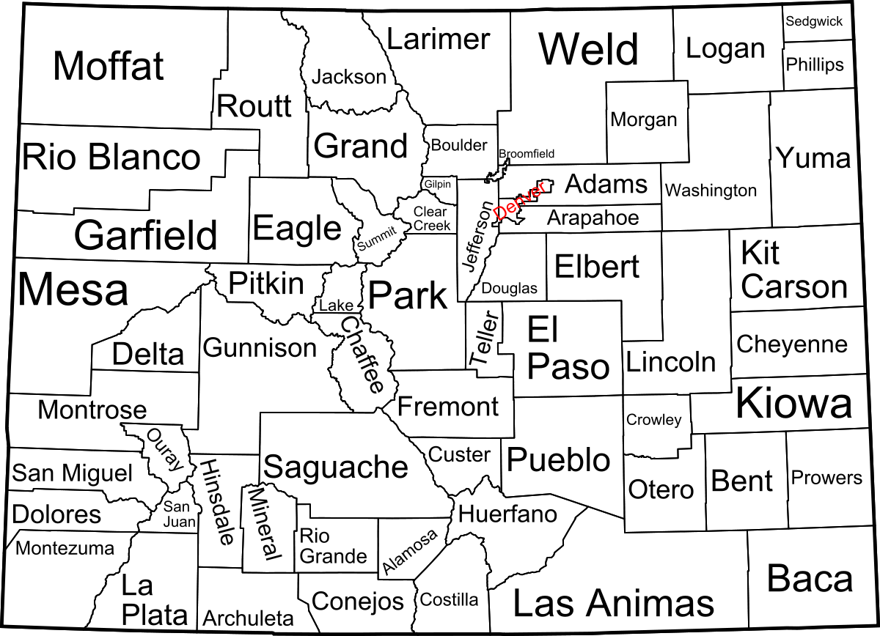
Water Level Changes from Base Line: by County
Counties with > 20’ decrease in average water levels

Slide 12
Summary
Based upon 221 wells from the National Ground Water Monitoring Network in the state of Colorado, mean water levels have fallen more than 10’ since 1980
Areas of significant decrease in water levels (>20’) are located in agricultural heavy areas of Eastern Colorado and in nearly all cases draw from the Ogallala Formation
Recommendations
To gain a better understanding of water levels throughout the state of Colorado, it is recommended more water level monitoring sites are added to the dataset.
In areas with significant decreases in water depths it is recommended water conservation practices are implementedto conserve the remaining resource. Such actions are critical to maintaining economic and environmental sustainability.

